Slide 1
Chapter 4: Signal Conditioning and Processing

Slide 2
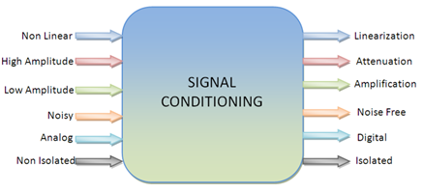
Importance of signal conditioning
Signal conditioning is an electronic circuit that manipulates a signal in a way that prepares it for the next stage of processing. Many data acquisition applications involve environmental or mechanical measurement from sensors, such as temperature and vibration.
This instrument converts one type of electrical or mechanical signal (input-signal) into another (output-signal). The purpose is to amplify and convert this signal into an easy to read and compatible form for data-acquisition.
Following are the some processes involved in signal conditioning

Slide 3
Function of a Signal Conditioner
The function of a signal conditioner is to pick up the signal from the load cell and convert it into a higher level of an electrical signal.
The output signals need to be converted to be usable for the instruments they are connected to. Through the use of a signal conditioner, any sensor signal can be converted to any standard process signal.
Signal Conversion
The main function of a signal conditioner is to pick up the signal and convert it into a higher level of electrical signal. Signal conversion is often used by industrial applications that use a wide range of sensors to perform measurements. Any sensor signal is capable of being converted to any standard process signal
Linearization
When the signal produced by a load cell does not have a straight-line relationship with the physical measurement, certain signal conditioners can perform linearization. The nonlinear output is interpreted by the signal conditioner and translated to the data acquisition device as a linear signal.

Slide 4
Amplification
Amplification is the process of increasing the signal for processing or digitization. An ADC has a particular dynamic range it is necessary to adjust the amplitude of the received signal to efficiently utilize the available dynamic range of the ADC. There are two ways that signal amplification can be performed; by increasing the resolution of the input signal, or by increasing the signal-to-noise ratio.
Attenuation
Attenuation, the opposite of amplification, is necessary when voltages to be digitized are beyond the ADC range. This form of signal conditioning decreases the input signal amplitude so that the conditioned signal is within the ADC range. Attenuation is typically necessary when measuring voltages that are more than 10 V.
Excitation
Excitation is required for strain gauge load cells which require external voltage or current excitation. Measurements are usually made with a current source that converts the variation in resistance to a measurable voltage. Strain gages, which are very-low-resistance devices, typically are used in a Wheatstone bridge configuration with a voltage excitation source.
Filtering
Signal frequency spectrum is filtered to reject any noise within a certain frequency range. A digital filter is a mathematical filter used to manipulate a signal, such as blocking or passing a particular frequency range.

Slide 5
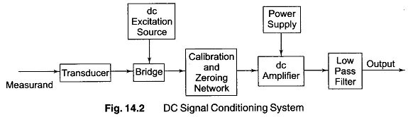
Block Diagram of Signal Conditioning Circuit
D.C. SIGNAL CONDITIONING SYSTEM
The resistance transducers are commonly used for the d.c. systems. The resistance transducers like strain gauge forms one or more arms of a Wheatstone bridge circuit.
A separate d.c. supply is required for the bridge.
The bridge is balanced using potentiometer and can be calibrated for unbalanced conditions. This is the function of Calibration and zeroing network.
Then there is d.c. amplifier which also requires separate d.c. supply.

Slide 6
The d.c. amplifier must have following characteristics:
Balanced differential inputs.
High common mode rejection ratio. (CMRR)
High input impedance.
Good thermal and long term stability.
The d.c. system has following advantages:
It is easy to calibrate at low frequencies.
It is able to recover from an overload condition.
But the main disadvantage of d.c. system is that it suffers from the problems of drift. The low frequency spurious unwanted signals are available along with the required data signal. For overcoming this, low drift d.c. amplifiers are required.
The output of d.c. amplifier is given to a low pass filter. The function of low pass filter is to eliminate unwanted high frequency components or noise from the required data signed. Thus the output of low pass filter is the required data signal. Thus the output of low pass filter is the required d.c. output from the d.c. signal conditioning system.

Slide 7
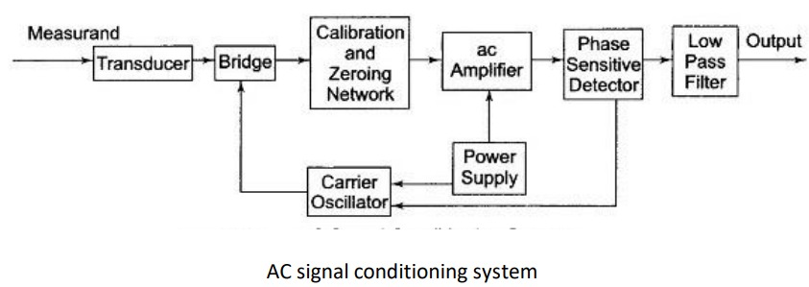
ii) A.C. SIGNAL CONDITIONING SYSTEM
The transducer used is variable resistance or variable inductance transducer.
The carrier oscillator generates a carrier signal of the frequency of about 50 Hz to 200 kHz. The carrier frequencies are higher and are at least 5 to 10 times the signal frequencies.
The bridge output is amplitude modulated carrier frequency signal.
The a.c. amplifier is used to amplify this signal.
A separate power supply is required for the a.c. amplifier.
The amplified signal is demodulated using phase sensitive demodulator.
The advantage of using phase sensitive demodulator is that the polarity of d.c. output indicates the direction of the parameter change in the bridge output. Unless and until spurious and noise signals modulate the carrier, they will not affect the data signal quality and till then are not important.
Active filters are used to reject mains frequency pick up. This prevents the overloading of a.c. amplifier. Filtering out of carrier frequency components of the data signal is done by phase sensitive demodulator.
The applications of such system are in use with variable reactance transducers and for the systems where signals are required to be transmitted through long cables, to connect the transducers to the signal conditioning system. This type of signal conditioning includes the circuits like sample and hold, multiplexers, analog to digital converters etc

Slide 8
Signal Amplification
A signal amplifier is a circuit that uses electrical power to increase the amplitude of an incoming signal voltage or current signal, and output this higher amplitude version at its output terminals.
The ideal signal amplifier creates an exact replica of the original signal that is larger but identical in every other way. In practice, a “perfect” amplifier is not possible, because no circuit can perfectly and proportionately scale up all aspects of a signal past a certain point.
Signal amplifiers are an essential component of thousands of devices, including landline and cellular telephone systems, music and public address systems, data acquisition (DAQ) systems, radio frequency transmitters, servo motor controllers, and countless more.
Signal amplifiers are an essential component of thousands of devices, including landline and cellular telephone systems, music and public address systems, data acquisition (DAQ) systems, radio frequency transmitters, servo motor controllers, and countless more.

Slide 9
In data acquisition (DAQ) systems, signal amplifiers are needed to increase the amplitudes from sensors that output small signals, up to the level where they can be sent to an A/D converter (ADC) for digitization. The typical analog-to-digital converter has an input aperture of ±5 V. Therefore, signals from thermocouples, shunts, strain gages, et al that are far lower than ±5V must be amplified significantly before they are sent to the ADC
Some common signal amplifiers found in today's data acquisition systems:
Differential amplifiers
Isolated amplifiers
Voltage amplifiers: low voltage amplifier, high voltage amplifier, DC voltage amplifier, AC voltage amplifier
Current amplifiers
Charge amplifiers
Thermocouple amplifiers
Strain gauge amplifiers: bridge amplifier, full-bridge amplifier, half-bridge amplifier, quarter-bridge amplifier)

Slide 10
Signal Filtering
In the field of signal processing, a filter is a device or process that, completely or partially, suppresses unwanted components or features from a signal. This usually means removing some frequencies to suppress interfering signals and to reduce background noise.
Types Of Filters
Passive Filters:
Passive filters are made up of passive components, such as resistors, capacitors & inductors.
It does not need any external source of energy. Therefore there is no voltage gain in these filters.
It can easily filter a high-frequency signal but it cannot process any low frequencies.
Design is simple but connecting a load to this filter impacts on its characteristics
b) Active Filters
In addition to the resistor & capacitor, uses an active component such as an operational amplifier, transistors, etc.
It needs external source of power, but provides a high voltage gain. This gain is used for amplifying any weak input signals.
The active filter can filter very low-frequency signals but it cannot process very high-frequency signal.
Complex design but they provide very high input & low output impedance. That is why; the load impedance does not affect the characteristics of the active filters.

Slide 11
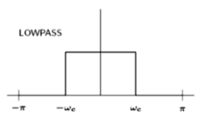
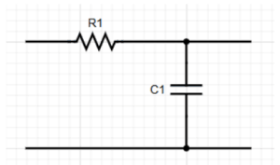
The operating frequency of the filter can be used to further categorize into low pass filter, high pass filter, band-pass filter, band-rejection file.
Low pass filter
A LPF is used in circuits that only allow low frequencies to pass through. It is often used to block high frequencies and AC current in a circuit.
LPF is popular with speakers to block high pitches, some electric guitars and radio transmitters.

Slide 12
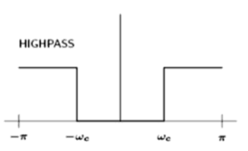
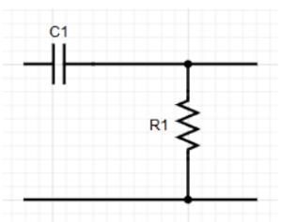
2. High pass filter
A high pass filter is used in circuits that only require high frequencies to operate. It blocks most low frequencies & DC component.
High pass filters are used to sharpen images.

Slide 13
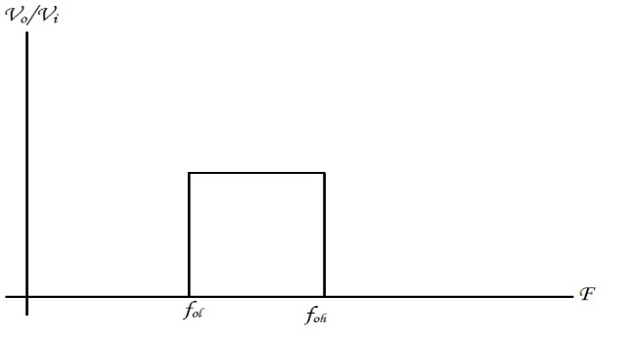
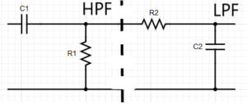
3. Band pass filter
A band pass filter is a combination of a high pass and a LPF. It allows only a select range of frequencies to pass through. It is designed such a way that the cut off frequency of the LPF is higher than the cut off frequency of the high pass filter, hence allowing only a select range of the frequencies to pass through.
Band pass filter is popularly with speakers to block high pitches, some electric guitars and radio/wireless transmitters and receivers.

Slide 14
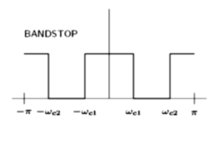
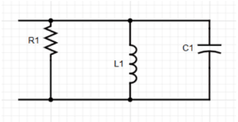
4. Band stop filter
A band stop filter also known as notch filter is used in circuits that block only a select range of frequencies and allows others to pass through. It would be an inverse of the band pass filter, and can be created by using the same input at a high pass and a LPF.
Band Rejection filter is heavily used in Public Address Systems, Speaker System and in devices that require filtering to obtain good audio. It is also used to reduce static radio related devices. The frequencies that bring in the static are attenuated by giving their frequencies as the limits.

Slide 15
Wave shaping
Wave shaping circuits are the electronic circuits, which produce the desired shape at the output from the applied input wave form. These circuits perform two functions −
Attenuate the applied wave
Alter the dc level of the applied wave.
Wave shaping technique include clipping and clamping.
In op-amp clipper circuits a rectifier diode may be used to clip off a certain portion of the input signal to obtain a desired o/p waveform.
Clippers
A clipper is an electronic circuit that produces an output by removing a part of the input above or below a reference value.
Clippers can be classified into the following two types based on the clipping portion of the input.
Positive Clipper
Negative Clipper

Slide 16
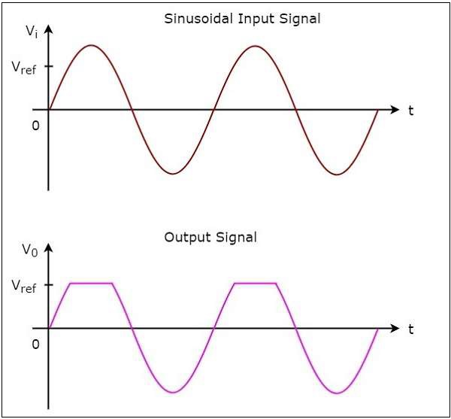
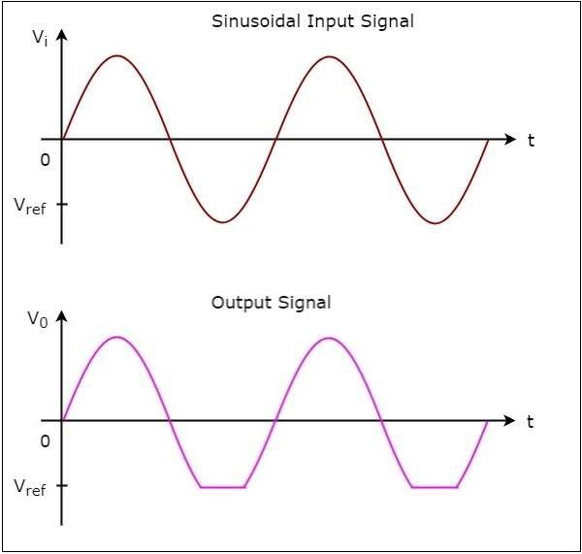
Positive Clipper: A positive clipper is a clipper that clips only the positive portion(s) of the input signal.
Negative Clipper: A negative clipper is a clipper that clips only the negative portion(s) of the input signal.

Slide 17
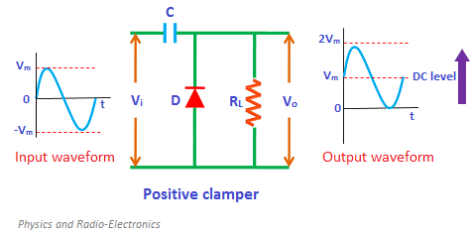
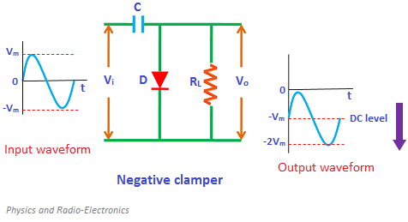
Clamper Circuit: A Clamper Circuit is a circuit that adds a DC level to an AC signal. Actually, the positive and negative peaks of the signals can be placed at desired levels using the clamping circuits. As the DC level gets shifted, a clamper circuit is called as a Level Shifter.

Slide 18
Isolation Amplifier
An isolation amplifier (also called a unity-gain amplifier) is an op-amp circuit which provides isolation of one part of a circuit from another, so that power is not used, drawn, or wasted in a part of the circuit.
It is basically an operational amplifier circuit which can be used to separate a section of a circuit from another. By doing so, it makes sure that power is not drawn or wasted in any part of the circuit.
The purpose of an isolation amplifier isn't to amplify the signal. The same signal that is input into the op amp gets passed out exactly the same. This means that output voltage is the same exact as the input voltage, meaning if 10V AC is input into a circuit, 10V AC is output.
The purpose of an isolation amplifier is to isolate the circuit which appears before the amplifier from the circuit that appears after it.
These amplifiers are used to give an electrical safety battier as well as isolation. These amplifiers protect the patients from the outflow of current. They crack electrical signal’s ohmic continuity among input & output and isolated power supply can be provided for both the input and output. So, the low-level signals can be amplified.

Slide 19
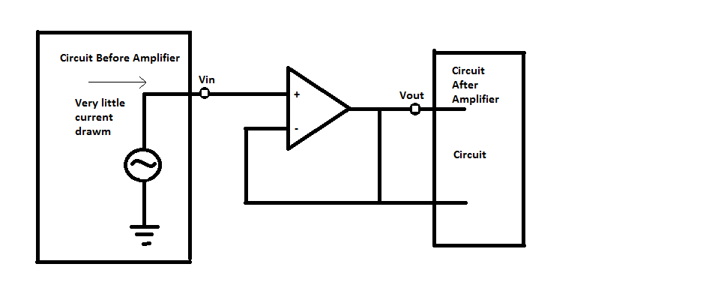
Isolation Amplifier Design Methods
There are basically three types of amplifier design methods followed
Transformer Isolation
Optical Isolation
Capacitive Isolation

Slide 20
Principle
When the input impedance of an op-amp is extremely high then the isolation can be caused. As this circuit includes high input impedance, then minute current can be drawn from the amplifier circuit. According to Ohms law, when the resistance is high, then the current will be drawn less from the power supply.
Therefore, an op-amp does not draw a significant quantity of current from the power source. So in practice, there is no current will be drawn as well as transferred from one portion to another portion of the circuit. Therefore, this amplifier works as an isolation device.
When the input impedance of an op-amp is low then it draws a vast amount of current. Ohms law states that, if load impedance has less resistance, then it draws huge current by the source of power so that high disturbances can be caused, and this is quite opposite to isolation. Here, isolation amplifier works like a buffer and they do not strengthen signals although provide to isolate divisions of circuits.

Slide 21
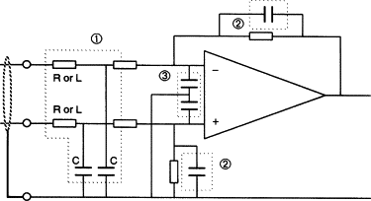
Interfering signal and their elimination
Interference occurs when unwanted radio frequency signals disrupt the use of normal system frequency operation. Interference may prevent reception altogether, may cause only a temporary loss of a signal, or may affect the quality of the sound or picture produced by equipment.
Signal Interference is a nonverbal Intervention that communicates that a behaviour is not appropriate.
Elimination
The level of the interfering signal can be reduced by restricting the operating bandwidth to the minimum acceptable. This can be achieved by input RC or LC filtering , feedback RC filtering, and low value (10–33 pF) capacitors directly at the input terminals.

Slide 22
b) For reducing the potential for harmful interference from a BPL device may be to reduce the RF power it generates.
c) Avoidance Of Locally Used Frequencies
d) Differential-mode Signal Injection oriented to minimize radiation
e) Use of filters and terminations to extinguish BPL signals on power lines where they are not needed;
f) Maintenance of single points of contact and BPL network control;
g) Use of web-based access to radio license information to avoid locally used radio frequencies
h) Use of one active device per frequency and area

